Slide 1

C Practice 4
Notes:
Click to add notes

Slide 2
C Programming Practice Question 1
Use while to print the numbers from 1 to 10.
Hint:
1. while (condition) { }
2. var++ or var = var + 1;
Notes:
Lesson descriptions should be brief.

Slide 3
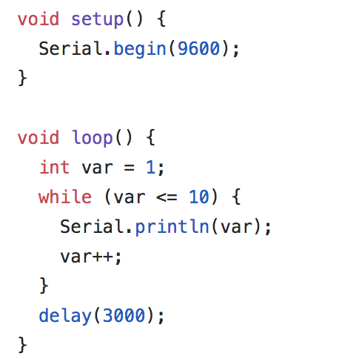
Answer
Notes:
Lesson descriptions should be brief.

Slide 4
C Programming Practice Question 2
Create an integer array with 5 elements: 10, 20, 30, 40, 50.
Use for statement to print each element in the array.
Hint:
1. int arr[5] = {….}
Notes:
Lesson descriptions should be brief.

Slide 5
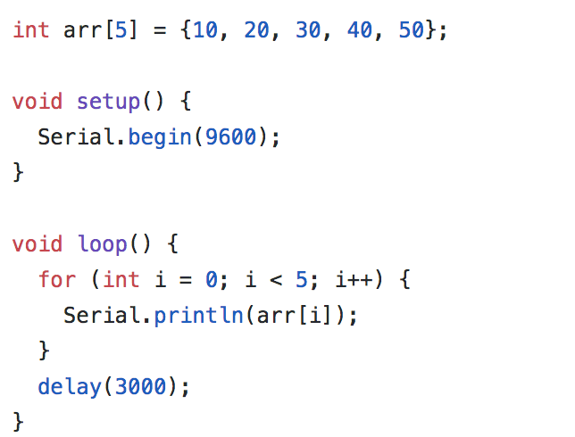
Answer
Notes:
Lesson descriptions should be brief.

